Slide 1
Logistic Regression

Slide 2
Logistic Regression
Logistic Regression is for classification problems, not regression problems.
Logistic Regression will need versions of the same three functions as Linear Regression:
Heuristic Formula – We need to change this to return a probability of a discrete classification ( how likely we think this is “true” ).
Cost Function – A convex cost function can be defined (no local minimas)
Gradient Descent – This will need to use the derivative of our new cost function, but will remain otherwise unchanged.

Slide 3
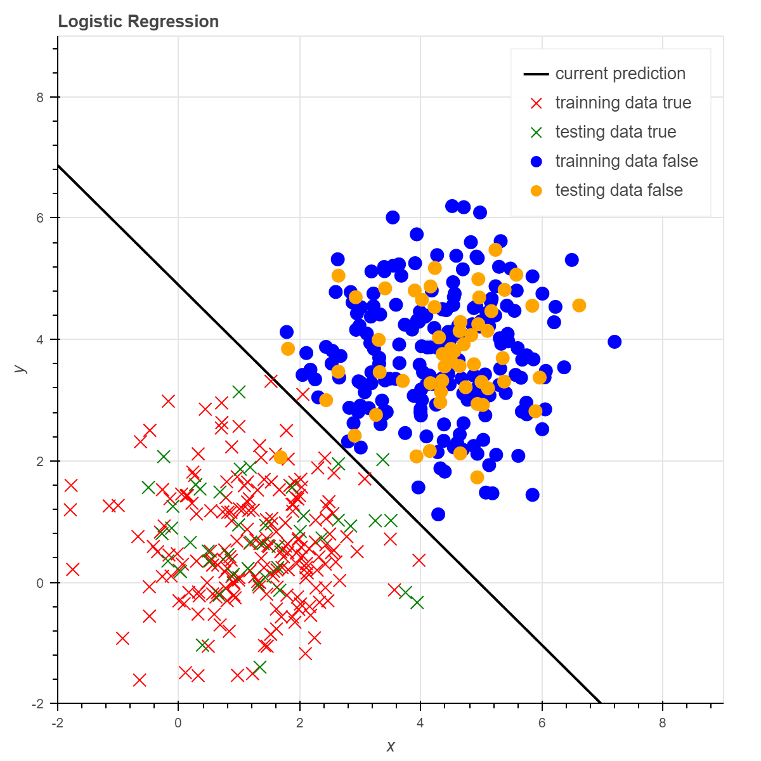

Logistic Regression - Heuristic
Logistic Regression attempts to map input values to a discrete output classification (probability).
We will start with the same heuristic used in linear regression, the sum-product of weights and inputs:
$θ^{T}x$ or $θ_{0}x_{0}+θ_{1}x_{1}+θ_{2}x_{2}+…+θ_{n}x_{n}$
Next we will need to map this continuous value to a ‘fuzzy’, 0 to 1 value.

Slide 4
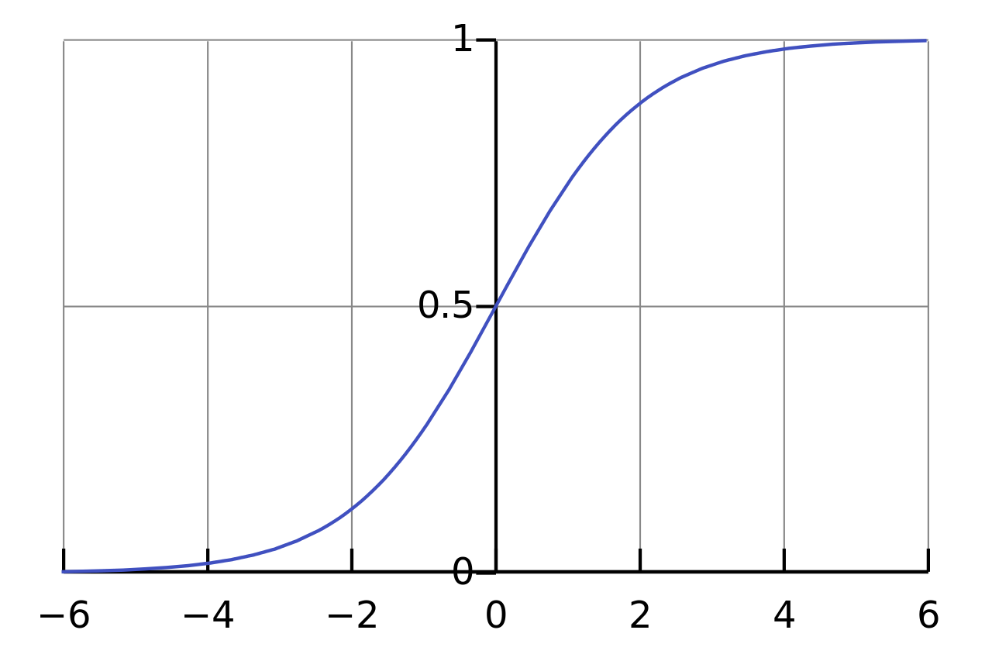


Logistic Regression - Heuristic
We can use the Sigmoid Function to map our output to a 0 to 1 probability value.
$g\left(z\right)= \frac{1}{1+ e^{−z}}$
If z >= 0 then $g\left(z\right)$ >= 0.5
Logistic Regression Heuristic:
$h_{θ}\left(x\right)=$ $g\left(θ^{T}x\right)$
$$g\left(z\right)$$
Z

Slide 5

Logistic Regression - Heuristic
Logistic Regression Heuristic:
$h_{θ}\left(x\right)=$ $g\left(θ^{T}x\right)$
For classification predictions, we can compare our output to 0.5:
$Y=1 if h_{θ}\left(x\right) ≥0.5$
$Y=0 if h_{θ}\left(x\right)<0.5$

Slide 6

Logistic Regression - Heuristic
Logistic Regression Heuristic:
$h_{θ}\left(x\right)=$ $g\left(θ^{T}x\right)$
The “bias” value in $θ^{T}x$ will control the decision boundary ‘distance’.
Just like in Linear Regression, polynomial features can be used to increase variance for more complex mappings.
The pictured example uses a simple line function for the decision boundary.
Distance controlled
by bias

Slide 7
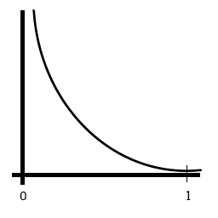
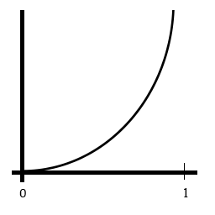



Logistic Regression – Cost Function
The Linear Regression cost function would not be convex if used with out Logistic Regression Heuristic.
If y = 1
$$J\left(θ\right)= \frac{1}{m}\sum_{i=1}^{m}{cost(h_{θ}\left(x_{i}\right), y_{i})}$$
If y = 1, then: $cost(h_{θ}\left(x_{i}\right), y_{i})$ = -log($h_{θ}\left(x_{i}\right))$
If y = 0, then:
$cost(h_{θ}\left(x_{i}\right), y_{i})$ = -log($1 −h_{θ}\left(x_{i}\right))$
If y = 0
$$h_{θ}\left(x\right)$$
$$h_{θ}\left(x\right)$$

Slide 8
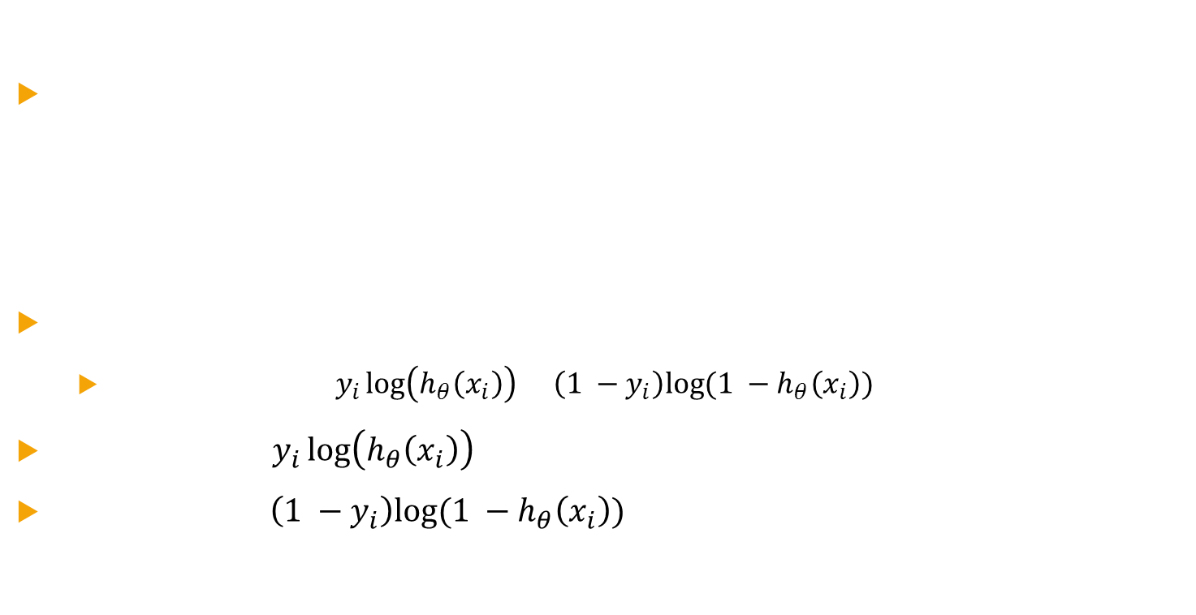
Logistic regression - Cost Function
$J\left(θ\right)= \frac{1}{m}\sum_{i=1}^{m}{cost(h_{θ}\left(x_{i}\right), y_{i})}$ If y = 1, then: $cost(h_{θ}\left(x_{i}\right), y_{i})$ = -log($h_{θ}\left(x_{i}\right))$ If y = 0, then: $cost(h_{θ}\left(x_{i}\right), y_{i})$ = -log($1 −h_{θ}\left(x_{i}\right))$
We can ‘simplify’ this function as follows:
$J\left(θ\right)=−\frac{1}{m}\sum_{i=1}^{m}{\left[y_{i}\log\left(h_{θ}\left(x_{i}\right)\right)+\left(1 −y_{i}\right)log⁡(1 −h_{θ}\left(x_{i}\right))\right]}$
When $y_{i}$ is 0, $y_{i}\log\left(h_{θ}\left(x_{i}\right)\right)$ will be 0
When $y_{i}$ is 1,$\left(1 −y_{i}\right)log⁡(1 −h_{θ}\left(x_{i}\right))$ will be 0

Slide 9

Logistic Regression - Gradient Descent
Logistic Gradient Descent is the same as Linear, at a high level:
repeat until convergence:
{
for each $θ_{j}$
$θ_{j}$update = $θ_{j}−α$ $\frac{∂}{∂θ_{j}}J(θ)$
for each $θ_{j}$
$θ_{j}$= $θ_{j}$update
}
We just need to define $\frac{∂}{∂θ_{j}}J(θ)$ for the new cost function.

Slide 10

Logistic Regression – Gradient Descent
repeat until convergence:
{
for each $θ_{j}$
$θ_{j}$update = $θ_{j}−\frac{α}{m}\sum_{i=1}^{m}{\left(h_{θ}\left(x_{i}\right) − y_{i}\right)} ∗x_{i}^{j}$
for each $θ_{j}$
$θ_{j}$= $θ_{j}$update
}

Slide 11
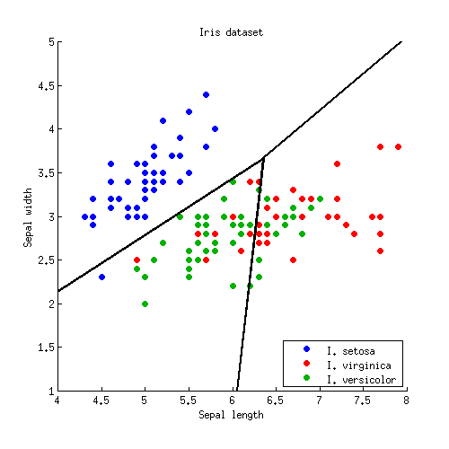
Multiclass classification
So far we can only classify a binary state, y = {0, 1} but we may have multiple possible classifications, such that y = {0, 1, 2, … n}
We can do this by choosing one of our possible classification outcomes, and performing our binary classification against that class. We then repeat this for each possible classification. This technique is called One-vs-All.

Slide 12

Further extending Logistic Regression
Hopefully we can see that Linear and Logistic Regression techniques share many characteristics.
Concepts including multiple features, polynomial features, regularization and normalization can all be performed in nearly identical manners in either Linear or Logistic regression.

